Slide 1
J & R Business Strategy
Marketing Strategy for
A.A.C.E/5 Star
October 2, 2015
Notes:
We are very excited about this campaign

Slide 2
Notes:
What is A.A.C.E.?

Slide 3
A.A.C.E
Athletics
Academics
Character
Excellence
Notes:
Athletics, Academics, Character And Excellence

Slide 4
A.A.C.E
Athletics
Academics
Character
Excellence
A.A.C.E is
“ the resource for student athletes progressing to college”
Notes:
In your own words, A.A.C.E. is
“ the resource for student athletes progressing to college” and we have learned it is even more than that.

Slide 5
Why are we here?
A.A.C.E. requires funding for its programs in support of the student athletes
Notes:
We are here because A.A.C.E. has a need that we can help meet.
WE have agreed that that need is funding and sponsors to support A.A.C.E. programs as we discussed on our meeting Sept 11 2015

Slide 6
Marketing Objective:
TO Obtain donations TO support A.A.C.E.’s Students AGES 8 - 20 expenses IN their trajectory towards college.
Notes:
Meeting A.A.C.E.’s need is our Marketing Objective.
Our goal
This is what we aim to achieve through the implementation of the proposed marketing strategy.
Every effort must be directed towards this end.
to obtain donations to support A.A.C.E.’s Students AGES 8 - 20 expenses in their trajectory towards college.

Slide 7
Marketing Strategy
TARGET AUDIENCE
Who we are directing our message to
Sources outside the present A.A.C.E. community: individual contributors, retail, commercial, financial institutions and corporate sponsors within designated counties
Notes:
The marketing strategy is the how we will do it.
Every tactic, every effort undertaken, will be coordinated and in agreement with the marketing strategy so that we are allocating all resources in a productive and concerted way with a reasoning behind it, a justification backing it up towards this end .
Our strategy targets a specific audience. This is who we will direct our message to because this is who will provide funding.
We understand people within the A.A.C.E. community are already involved and committed to supporting the organization in various ways, have invested in events, fees, for their own kids, etc. So, we need to focus our audience on sources outside the present A.A.C.E. community, namely individual, contributors and corporate sponsors within designated counties: Retail, commercial, financial, individuals and corporations. This segment is a traditional source of funding in the categories of education and sports.

Slide 8
Marketing Strategy
CREATIVE STRATEGY
Defines who we are
Why we are worthy of support
How we get the message out
Notes:
The Creative Strategy capitalizes on:
1.The brand image. Who A.A.C.E., how AACE present itself to our target audience, not to our kids, not to the parents of A.A.C.E. kids, but to potential contributors. The image is also how we conduct ourselves, we need to be like we say we are. We claim an image and we support it. It is valueless to send a message that can not be backed up.
2. What we say to our audience that will to elicit the desired response. What makes us look worthy of their support.
3.How we get that message out to our audience.

Slide 9
Creative strategy
Graphic Strategy
Message Strategy
Media Strategy
Notes:
Our creative strategy is based on principles of mass communication science, maximizing effectiveness in eliciting the desired response in our target audience towards our marketing objective, under budget limitations, and so we are focusing on three fundamental components:
The Graphic Strategy begins with the creation of a new branding image that is aligned with the A.A.C.E. Mission and Goal. Consistent graphic elements are incorporated on all media.
2. The Message strategy will consistently determine what is said, what is shown, what is heard from us by our audience. Whether it is a paragraph, a photograph or an audio track, it will be designed to meet the Objective.
3. We will reach our audience through viable media accessible within the capability of A.A.C.E., especially social media, outdoor presence and direct marketing where applicable and capitalizing on social assets and networking.
Our graphics are the first resource we will exploit towards our objective. Our graphic strategy will define A.A.C.E. through impactful visual representation of the organization and its mission, which will build the brand image.

Slide 10
The A.A.C.E. MISSION TO BE the resource for student athletes progressing to college
Notes:
A brand image is based on and backed up by the mission.
Let’s take a look at our mission:
A.A.C.E. does more than influence positive change. It is not about changing or fixing something. A.A.C.E. is more about safeguarding something good, the potential in children, honoring and upholding their value and their rights, providing resources and opportunity and increasing unmeasurably the odds of a quality future.
The mentoring, academic support, training, etc. are all the components of your strategy. How you accomplish your mission. Tool at your disposal.
This part is really the summarized mission. The mission validates our existence and the support we seek. The goal is to help kids make it.

Slide 11
The A.A.C.E. MISSION to be the resource for student athletes progressing to college
AND BEYOND
Notes:
So A.A.C.E. is the resource for student athletes progressing to college…. and beyond.
In their trajectory to college, these kids have learned resilience, dedication, persistence, what it takes to be successful and they have learned to strive to be successful.

Slide 12
THE A.A.C.E. MISSION: To instill a culture of personal, Academic and Athletic achievement for lifelong success in today’s youth.
Notes:
So we have reworded mission to direct it more effectively to our target audience.
To instill a culture of personal, academic and athletic achievement for lifelong success in today’s youth.
Short and sweet….to the point. The way our target audience listens. It presents an undeniably worthy cause. Long term effect is important, more appealing, a sound investment.

Slide 13
Notes:
We have a name: A.A.C.E. We like what the letters stand for, but I must admit I have a hard time remembering all four disciplines if called on it, mostly because it is a list. The human brain doesn't like to memorize lists. Phrases and sentences are more easily remembered. But it is already simply called AACE, ACE and that we can work with.

Slide 14
AACE
Notes:
So, we make it an acronym: AACE, no periods, no pause in pronunciation, and it sounds like an ACE. Ace is good, wins at poker, flies jet fighter planes, the first, the best, the winner. And all that is aligned with our 4 disciplines.

Slide 15
Notes:
The current logo is a visual representation with some icons that evoke elements in the mission, it is associative to academics… not memorable… not visually impactful and it does not look “cool”.
So, this is not performing towards the objective, not contributing to make us stand out. Not doing the job a logo is meant to do. There is too much info, too much clutter that does not create a coherent design. We do not want to spend any money on something that is not an effective impactful, original representation of AACE that will do the job of being memorable and strengthening the image based on our mission in the mind of our audience.
As part of our graphic strategy, everything graphic, designed, printed, stitched on, needs to be there for a reason, needs to be significant, justified and needs to sell. Sell our brand and our merit. Needs to be aligned with the objective. There is too much message clutter distracting our audience, so we need to make a point quickly and be memorable, not look like anything else. It needs to look cool.

Slide 16
Creative STRATEGY - Graphics
Academics
Athletics
Character
Excellence
Notes:
Design poses a challenge because we are dealing with non-tangibles, Academics,

Slide 17
Creative STRATEGY - Graphics
Academics
Athletics
Character
Excellence
Notes:
Athletic Achievement, (not just sport of a specific kind we have basketball, football, track). We have 5 stars, which is a big part pf A.A.C.E. Character, we know what is, but try to explain it or visualize it…it’s a perseverance, a not giving up, a warrior-like moral fortitude and endurance. Excellence is easier to represent….

Slide 18
Creative STRATEGY - Graphics
#1
Academics
Athletics
Character
Excellence
Notes:
Excellence, and character.
Excellence is easy: cream of the crop, top of the line A+, #1, numero uno, etc.

Slide 19
Logo
New brand image that will define the AACE organization and its purpose, through a strong and relevant graphic design that will be visually memorable and significant.
Notes:
The new logo will represent the AACE Mission and Goal, will define the AACE organization and its purpose through a strong and relevant graphic design that will be visually memorable and significant. It will work for our present marketing objective, but it will function effectively for all AACE general image branding needs. In other words it will work for our funding and it will work as a spirit -building icon from here on.

Slide 20
Notes:
The name brand AACE acronym now carries a distinctive image that emphasizes the pronunciation, avoids confusion on how to say the name, but keeps the letters AACE present.
We incorporate an icon that can be used with the acronym in various formats.

Slide 21
Notes:
The new logo features an Ace of Spades icon, representing not only the top card in the deck, Spades -- called "piques" in the French system -- represented the nobility, standing in for the lances of knights. Although the name of the suit resembles the digging implement, the name "spade" actually comes from the Italian "spada," which means "sword," the corresponding suit in Italian card decks. In English, as in French, the Spade suit represents weapons, hence an association with a warrior. The spade symbolizes wisdom, acceptance and labor, all virtues conducive to good character. It is also represents earth in regard to the four elements and is a leaf from the cosmic tree representing life. This image is in agreement with the marketing strategy, but it will also be very well received by the participants in the program and exciting for the ACCE community all around. Read more : http://www.ehow.com/about_5192250_spade-symbolize_.html
So the spade is the backdrop of our motto in a graphic bold original yet subliminal way. We have a scholar and a book for academics, a trophy for athletic achievement, a 5 pointed star symbolizes excellence as well includes the 5 Stars Skills Camp.

Slide 22
Creative strategy
Message Strategy
Notes:
The message strategy will adhere to principles of mass communication science, maximizing effectiveness in eliciting the desired response in our target audience. It will consistently present talking points derived from our mission, that are relevant toward our objective, that use target audience appropriate and persuasive language, copy and images throughout all media.

Slide 23
ATHLETICS AND ACADEMICS
FOR CHARACTER AND EXCELLENCE
THE RESOURCE FOR STUDENT ATHLETES
PROGRESSING TO COLLEGE AND BEYOND
MISSION
TO INSTILL A CULTURE OF PERSONAL, ATHLETIC AND ACADEMIC ACHIEVEMENT FOR LIFELONG SUCCES IN TODAY’S YOUTH
Notes:
We will update the motto keeping the content but making it a phrase, more easily remembered and a more effective element in our message.
This is what AACE is. AACE = this valuable resource in a nutshell
The Mission has been reworded to include stronger language like instill, culture and lifelong and make it a more attractive and worthy philanthropic investment.

Slide 24
SLOGAN:
I am ACE.
I amaze!
Notes:
Our slogan was created to promote the validity AACE and its mission, to out target audience towards the objective of obtaining funding. The slogan will be proclaimed by the student athletes, the staff, members of the AACE community, and willing sponsors. It will also acknowledge and flatter sponsors, unify the AACE community and motivate the participant with a purposeful chant.

Slide 25
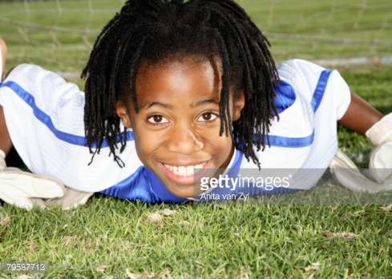
I am ACE

Slide 26
I amaze!

Slide 27
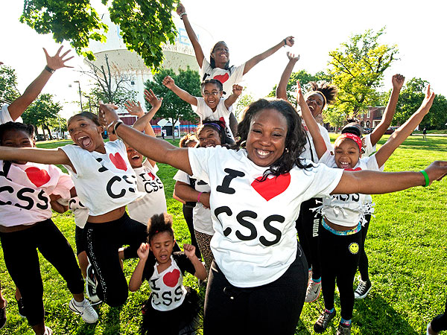
I am AACE

Slide 28
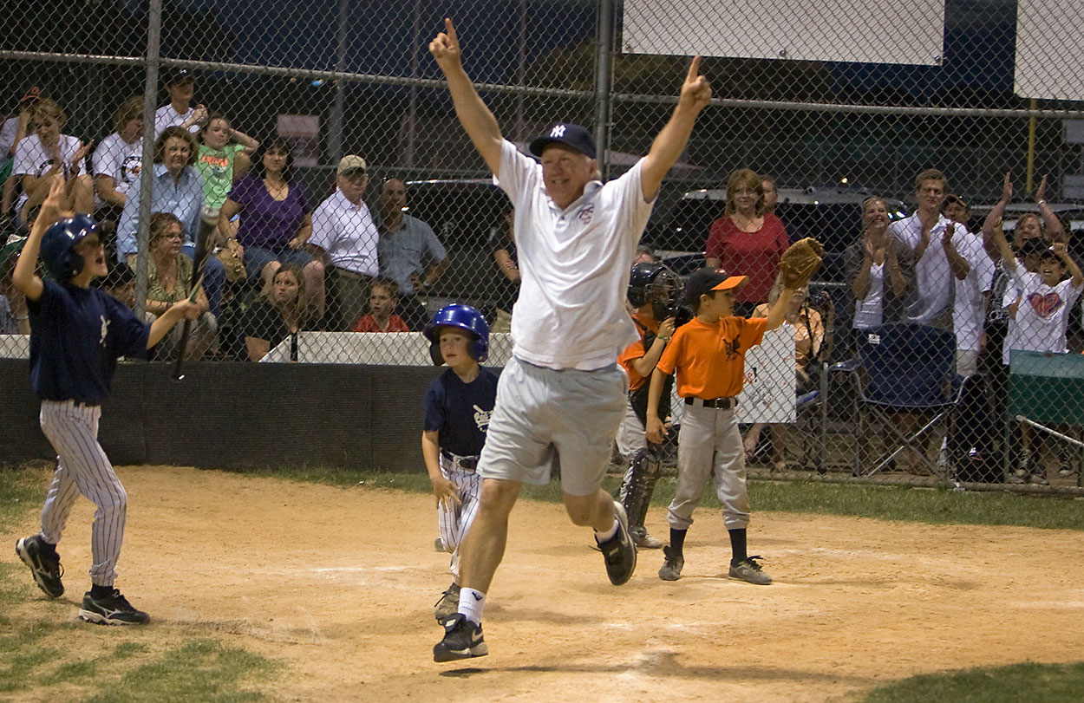
I am ACE

Slide 29
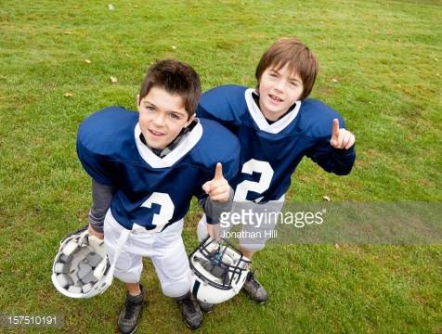
I amaze
I amaze

Slide 30
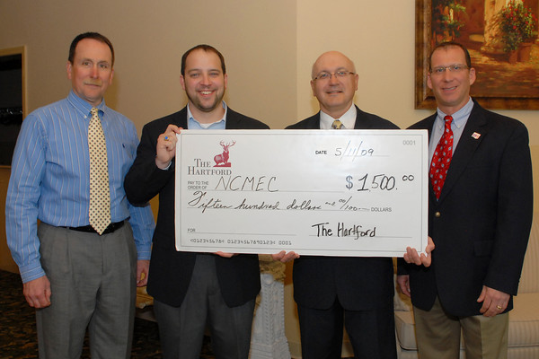
I am ACE

Slide 31
I am ACE

Slide 32
Creative strategy
Media Strategy
Website, social media, outdoor signage, web events, direct marketing,
Notes:
We will reach our audience through viable media accessible within the capability of AACE, especially social media (Website, Blog, Facebook Page, Instagram, Pinterest, twitter, linkedin). Outdoor presence and direct marketing where applicable and utilizing the social assets and networking.
A persuasive invitation to support ACEE will originate from the website, and radiate throughout the internet to target groups and social media events. Sponsor acknowledgement….

Slide 33
Media Strategy

Slide 34
Web Presence Optimization: Building and optimizing the social media presence
• Sponsorship Acknowledgement

Slide 35
Notes:
Message strategy based on principles of mass communication science, maximizing effectiveness in eliciting the desired response in our target audience, this will reach our audience through viable media accessible within the capability of AACE, especially social media,

